Slide 1
CM311 Proximity Detection System Trial
John Turner – Executive General Manager Mining Safety

Slide 2
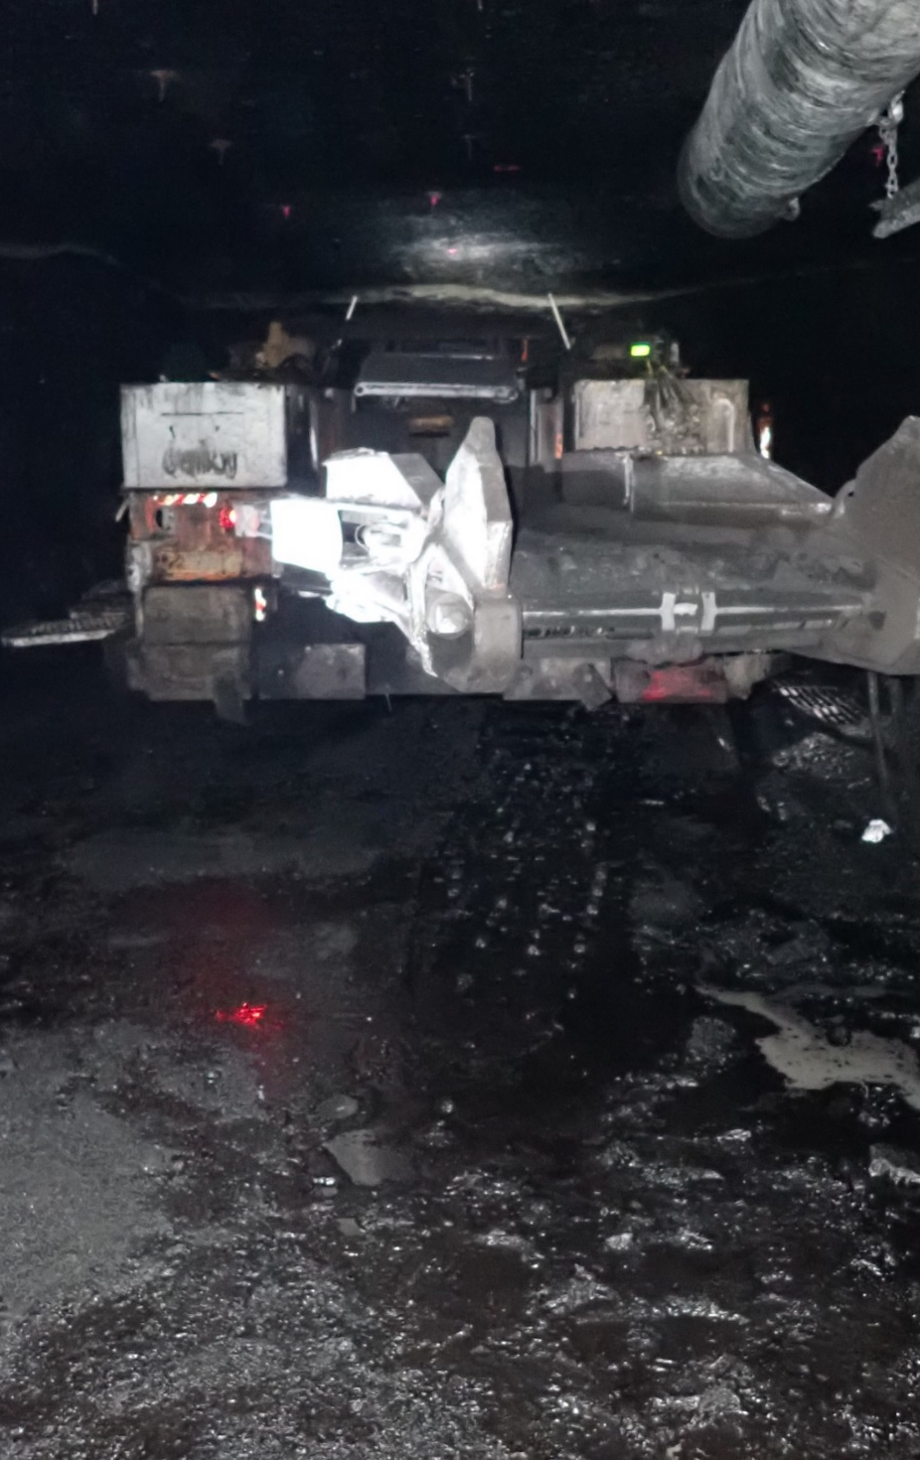
The Journey so far….
2021 – Consistent with longer term Proximity Management program, Centennial decided to trial a proximity detection system on a continuous miner in a production environment after an incident where an employee was seriously injured by a continuous miner boom.
2021/2022 –CM311 (Joy 12CM12 Bolter Miner) was overhauled incorporating the Centennial Mode Lighting Standard and was also fitted with both the Hardware and software to Trial Strata Technologies Hazardadvert Proximity Detection System.
August 2022 – Surface commissioning of the system commenced onsite at Myuna and so the learnings began.
February 2023 – Have not started the formal UG Trial due to an issue with repeatability.
OUR WAY IN ENERGY

Slide 3
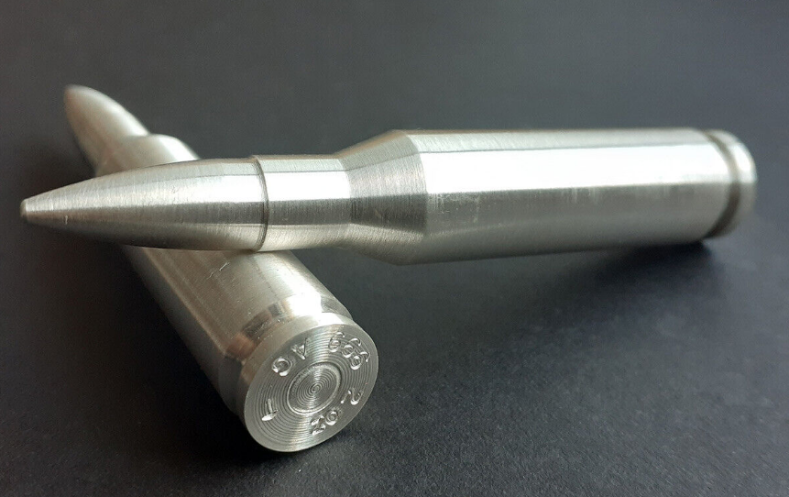
The Journey so far….
This presentation will detail a practical trial of this technology in a production environment, outline hurdles that encountered and how they have been managed, and also detail the current issue impacting the trial which will be critical to the outcome.
OUR WAY IN ENERGY

Slide 4
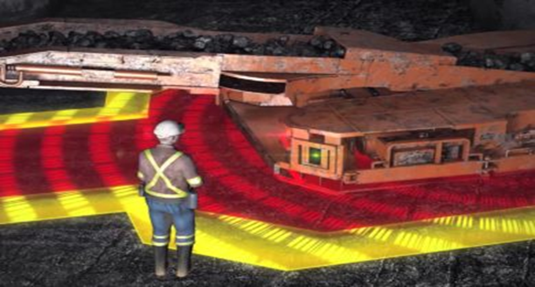
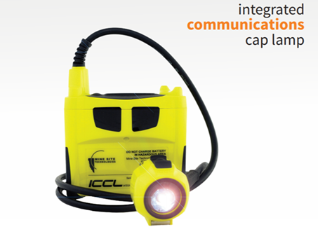
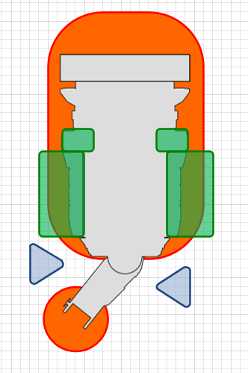
System Requirements
The application of a system at Myuna (and within Centennial) is different to longwall operations due to the mining systems in place.
In this application the CM Operator will stand behind the platform during some parts of the cycle and the controlled safe area between CM platform, the rib and the conveyor boom is limited.
To date this has been managed through No Go Zones, training, procedural controls, complemented more recently by Mode Lighting to clearly indicate which mode the Miner is in and whether it is safe to pass.
- Drivers Position in Plunge
OUR WAY IN ENERGY

Slide 5
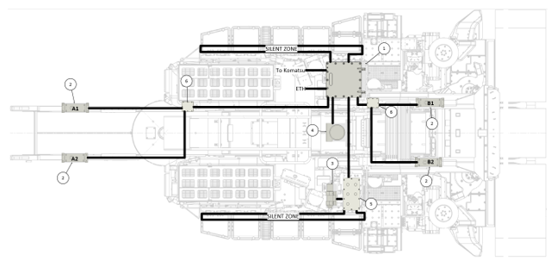
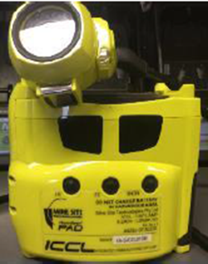
System Functionality
  Hazard Zones
  The system utilises Four signal generators in specific locations on the CM to generate the required magnetic field shape that match our designated Hazard zones.
  All persons operating the continuous miner undertaking the trial will be wearing a modified cap-lamp that has a tracking pad fitted which will work with the generated magnetic field and stops the continuous miner if the cap lamp is detected in the Hazard zone.

Slide 6
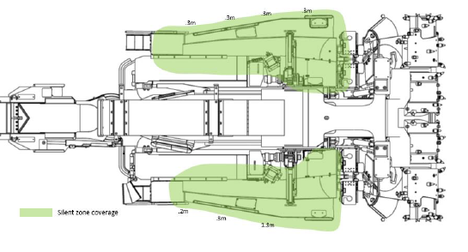
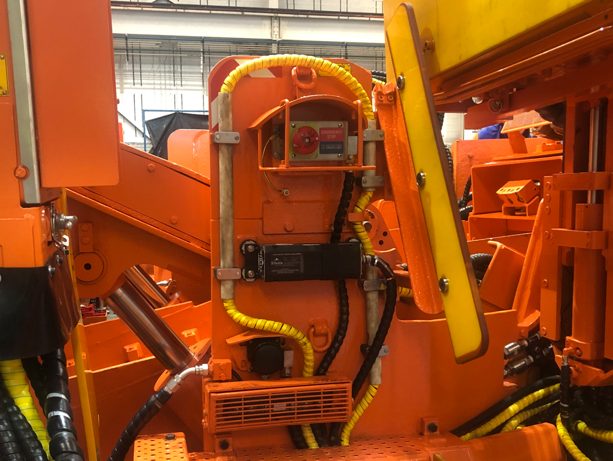
System Functionality
Silent Zones
  Silent Zones are installed on either side platforms to allow operators to safely work during the mining process without activating the Hazard zone stop function whilst in Mining mode.

Slide 7


Zone requirements
  By using the Signal Generators and the Silent Zone in conjunction with the PAD’s on the Cap lamps this is basic zoning required to operate the miner.
  To date zones achieved are very close to the area’s as marked in an ideal workshop situation
  However, repeatability issues have been observed where the system only operates as required 8 out of 10 times on average.
HAZARD ZONES
OUR WAY IN ENERGY

Slide 8
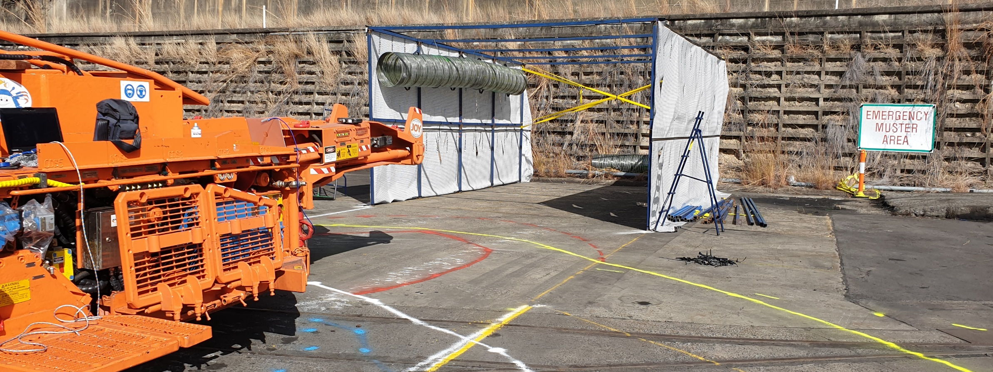
Proximity Detection System Commissioning
  Learning opportunities
  Simulation Tunnel
    A mock heading was constructed to simulate an underground environment.
    Inconsistent stopping distances when flitting in, out, near the simulation tunnel. The frame was bolted to the concrete although acted like a Faradays cage.
    Due to this inconsistency, the simulation tunnel was not used.
Notes:
SHS and brattice
Possibly creating a Faradays cage

Slide 9
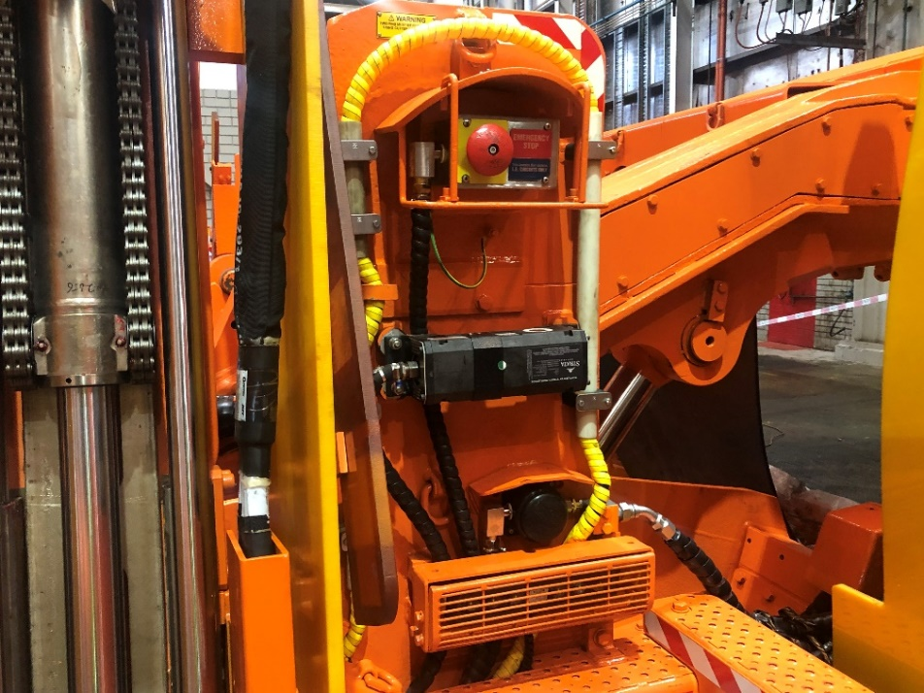
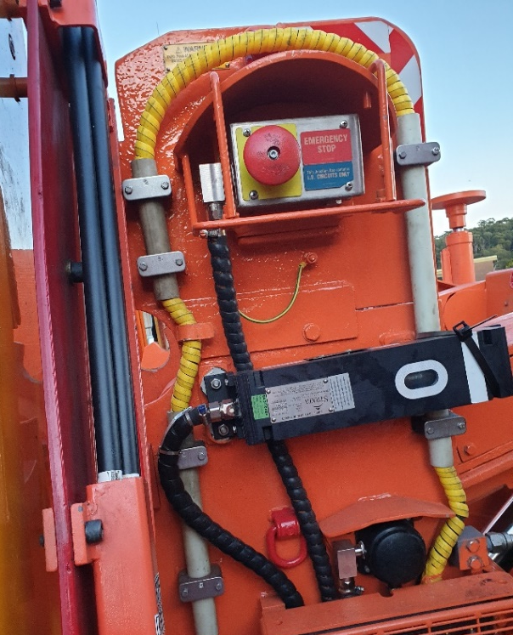
Proximity Detection System Commissioning
Learning opportunities
  Power output; too high
    When the original front generators (compact style) were installed the output power was set at 100% which created inconsistent tripping distances.
    These generators were replaced with a different style, allowing the trip zone to be more consistent.
Notes:
Too high; Generators would intermittently pulse and create a much larger trip zone.
Too low; Generators would have inconsistent stopping distances when slewing boom. “Tricked” the generators.

Slide 10
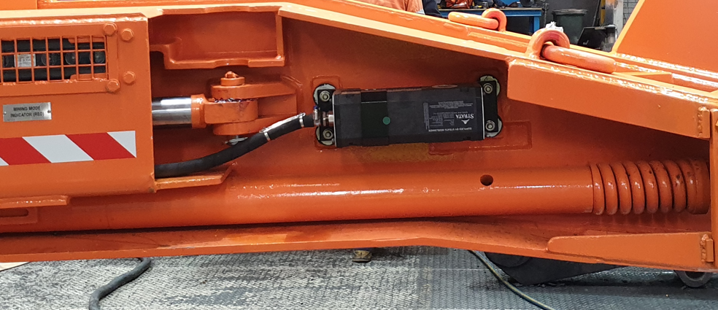
Proximity Detection System Commissioning
Learning opportunities
  Power output; too low
    Rear generators output power was running at a level that was too low to maintain stability.
    The rear generators were detuned to allow for a higher software power setting yet maintain the same tripping distance.
Notes:
Too high; Generators would intermittently pulse and create a much larger trip zone.
Too low; Generators would have inconsistent stopping distances when slewing boom. “Tricked” the generators.

Slide 11
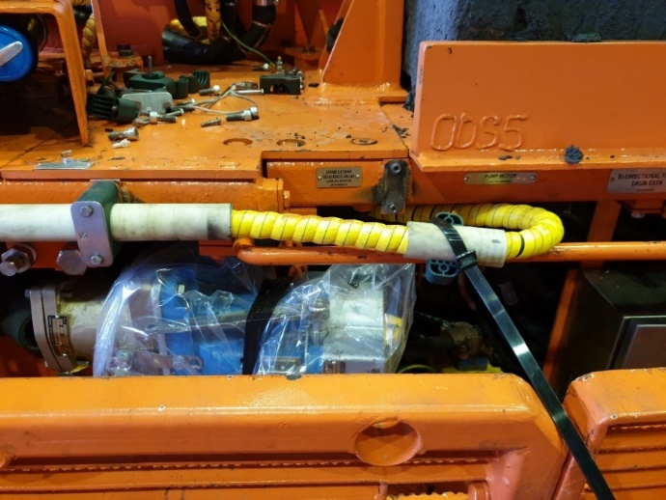
Proximity Detection System Commissioning
Learning opportunities
  Silent Zone; sizing
    The Silent Zone was too large and captured the corner of the CM. Modifications were made to the Silent Zone cabling which introduced issues of its own.
    Found small changes to cable reticulation has big effects on the shape and size of the Silent Zone.
    Therefore, if Silent Zone cabling is moved for maintenance or repair purposes the cabling will require re-positioning and silent zone
    re-commissioned.
Notes:
Found LHS silent zone too small.
Suspected issues with silent zone boards.
Ran silent zone on RHS board only. Same result.
Ran silent zone on LHS board only. Same result.
Modified silent zone cable. Extended cable out so that it ran along handle further before sneaking in underneath covers.

Slide 12
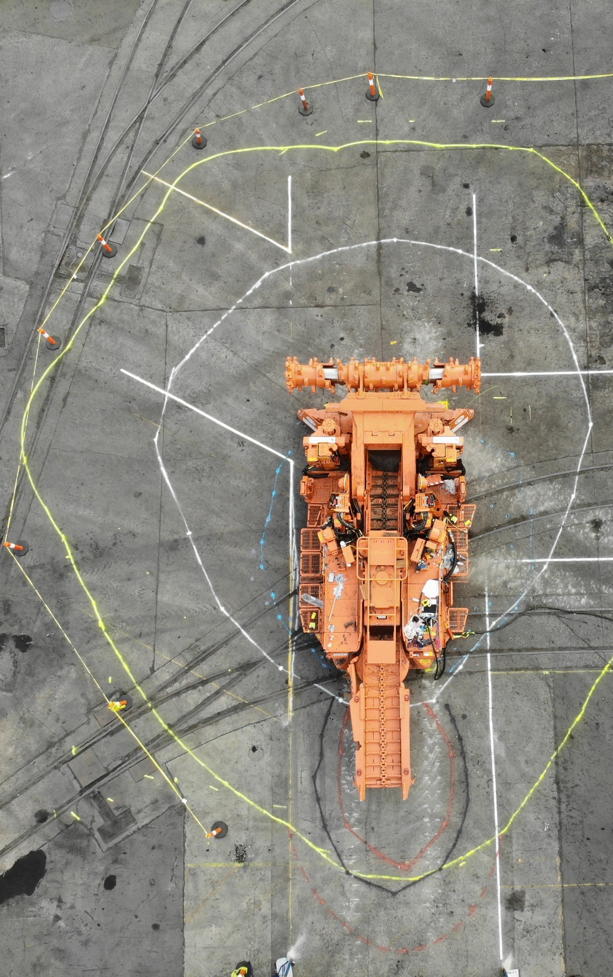
Proximity Detection System Commissioning
Learning opportunities
  Steel interference
    When mapping the trip zones around the CM found irregular pattern that coincided with the location of steel plates on the ground.
    Initial trials UG has shown that steel roof support does not have a significant effect on detection zones
Notes:
- Demonstrate abnormal mapped zone i.e.; dotted yellow lines

Slide 13
Proximity Detection System Commissioning Results
Underground
  Commissioning
    Mining conditions include roof meshed and ribs bolted.
    Results are as follows but indicated repeatability of app. 80%:
    The same tests were performed again with two (2) different cap lamps.
    With similar results, swinging both ways.
LEFT TO RIGHT
TEST | STOPPING DISTANCE FROM TAIL | NOTES
1 | Human and machine interaction then stopped | Mesh in rib near CM boom
2 | 300mm
3 | Human and machine interaction then stopped
LEFT TO RIGHT
TEST | STOPPING DISTANCE FROM TAIL | NOTES
1 | ~800mm | Cap lamp hung from roof mesh and secured therefore cap lamp no longer rotating
2 | ~800mm
3 | ~800mm
4 | Human and machine interaction then stopped
5 | Human and machine interaction then stopped
6 | ~800mm
LEFT TO RIGHT
TEST | STOPPING DISTANCE FROM TAIL | NOTES
1 | ~800mm | Cap lamp hung from roof mesh, but not secured therefore cap lamp rotating
2 | ~800mm
3 | Human and machine interaction then stopped
4 | Human and machine interaction then stopped
5 | ~800mm
6 | Human and machine interaction then stopped
RIGHT TO LEFT
TEST | STOPPING DISTANCE FROM TAIL | NOTES
1 | ~300mm | boom swings noticeably slower right to left
2 | ~800mm
3 | ~400mm
4 | ~800mm
5 | ~800mm

Slide 14
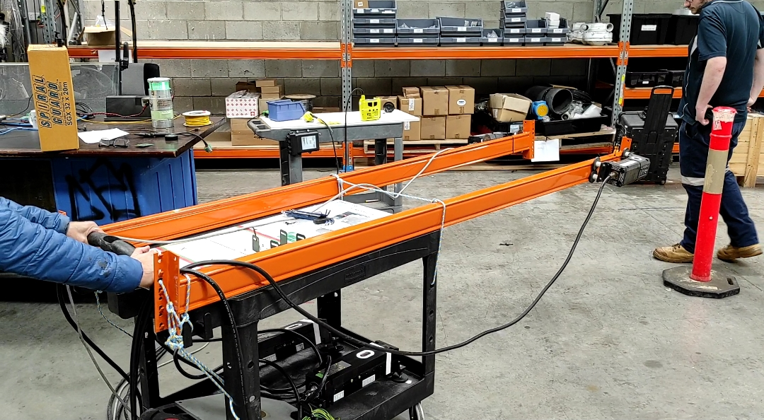
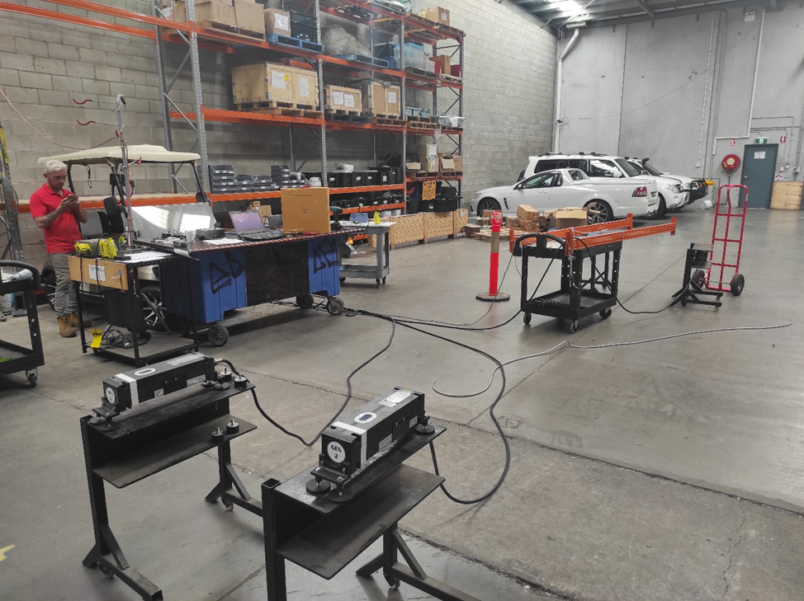
Proximity Detection System Commissioning
Strata HQ
  Cap lamp investigation
    Strata then went through a rigorous testing regime in their workshop on the system with Myuna’s modified Cap lamps and generators on a moving trolley as below with no obvious issues found.

Slide 15


Next step
Strata’s plans going forward
  Testing has identified the system works correctly until the boom starts moving which supports an interference issue. This is likely from items such as solenoids, VFD’s or other noise emitting hardware that is active during a boom swing. A series of tests will be conducted to ascertain the source of the interfering signal which may lead to the installation of Filters within the circuit.
  New firmware is being tested during February in the USA that better mitigates interfering signals. The PAD (alarm device on person) utilizes firmware optimized for maximum range, whereas this application requires very short range which can be modified.
  Cable used to connect the Generators did not use twisted pair (noise immunity) that may assist with the noise, pending the above tests, which they are predicting will address the reliability issue.
What we don’t want is a system that introduces complacency for the operators along with a system that isn’t 100% reliable and therefore potentially adding another layer of hazard.

Slide 16
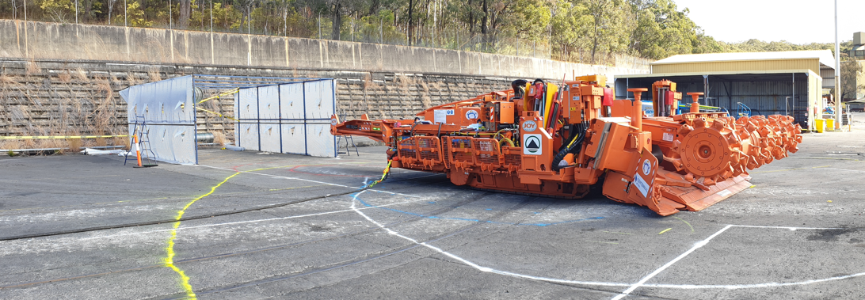
Key Points
  Proximity Detection Technologies are available for Underground Coal applications
  However, as demonstrated in this presentation, these system require significant work and customistion to provide a reliable control to the risk of an equipment to person interaction. This is especially relevant where the mining method or application is unique, or sufficiently different from existing deployments of the technology.
  Over the last 6 months the Team at Strata Technologies and Centennial Coal have been working together to get this system to work in this application with the trial currently achieving 80% reliability. Which means …
  Further work is required as 100% reliability is highly desirable
OUR WAY IN ENERGY

Slide 17
Update….
Centennial and Strata have continued to work together to make this trial asuccess
Detailed investigation since the forum has found an issue with the configuration of the software
This issue has now been resolved and limited trials have shown 100% repeatability
The trial will now resume

Slide 18
Other Information from the Collision Avoidance Forum

Slide 19
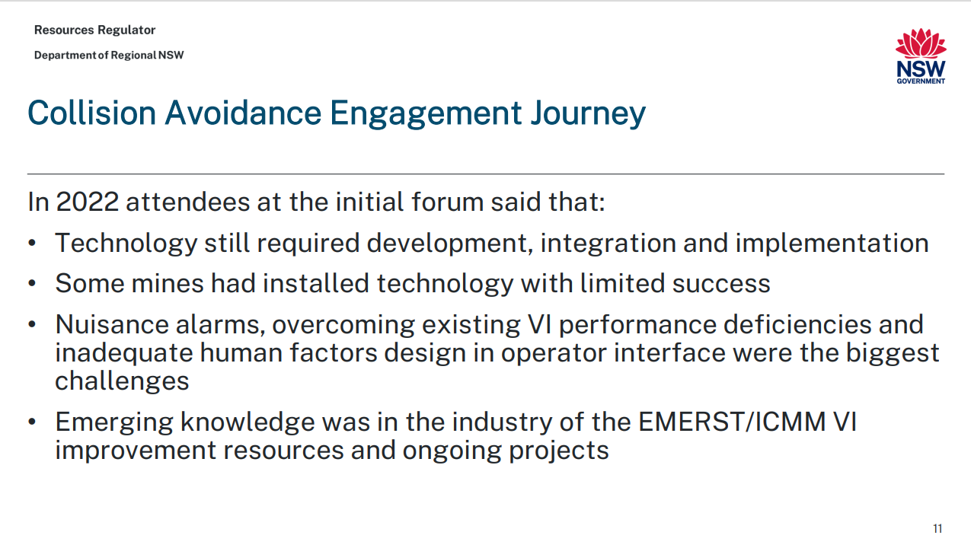

Slide 20
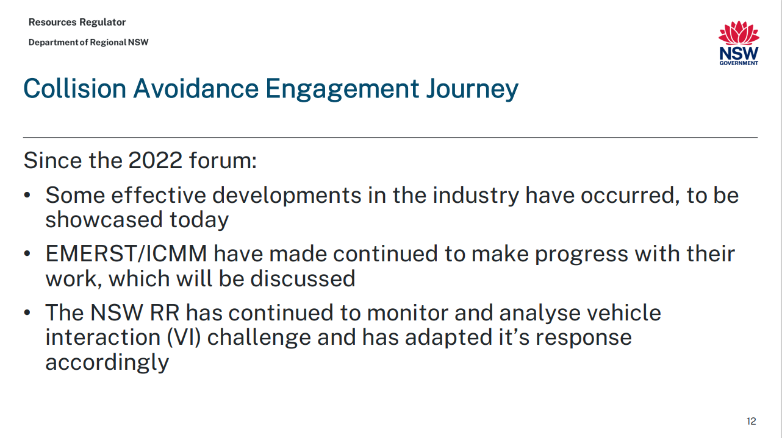

Slide 21
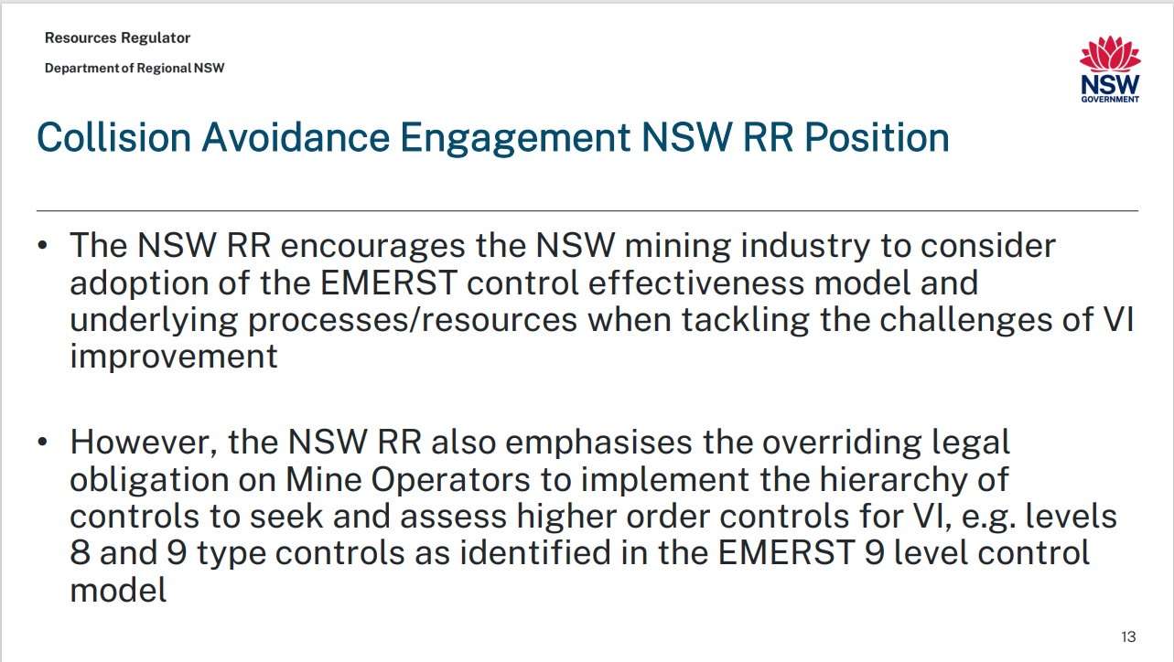

Slide 22
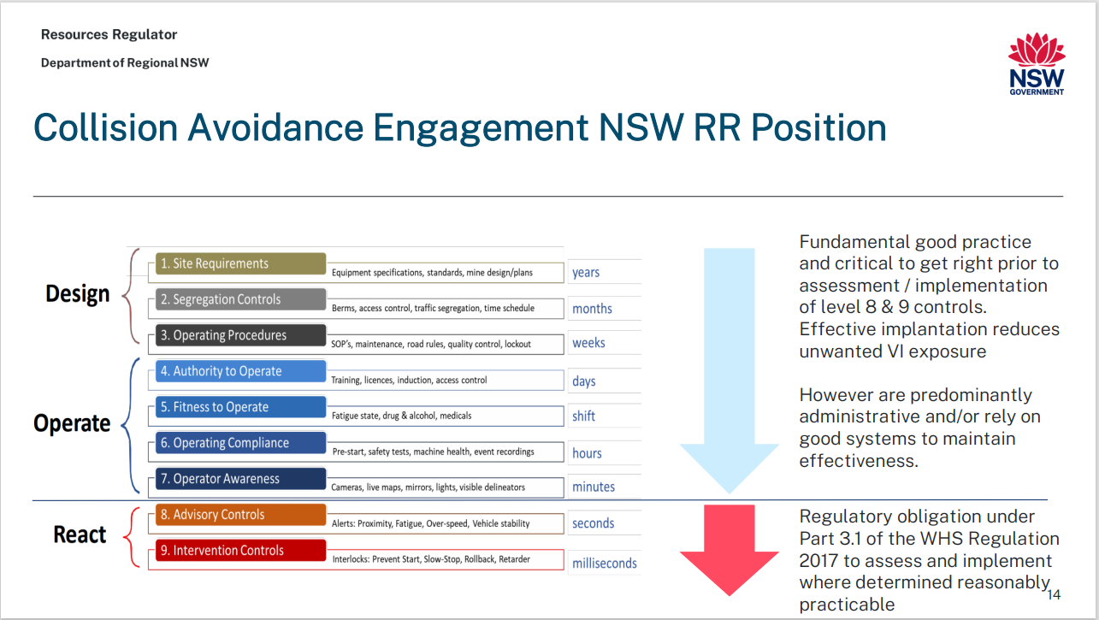

Slide 23
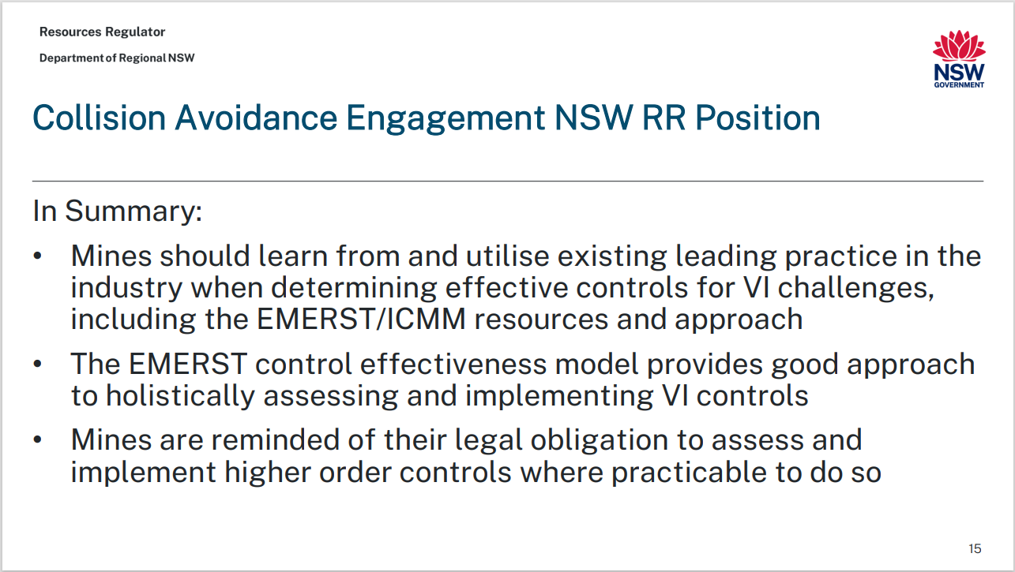

Slide 24
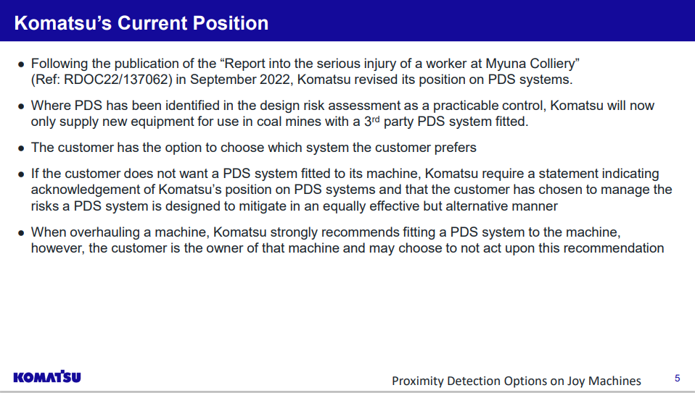

Slide 25
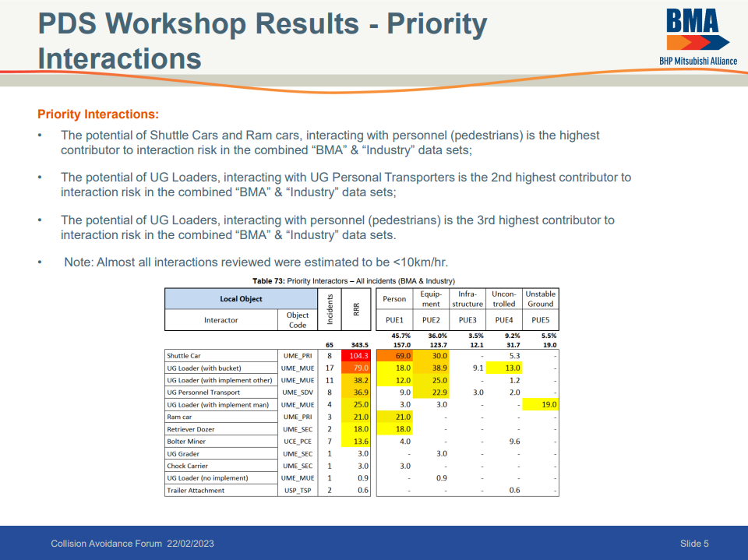

Slide 26
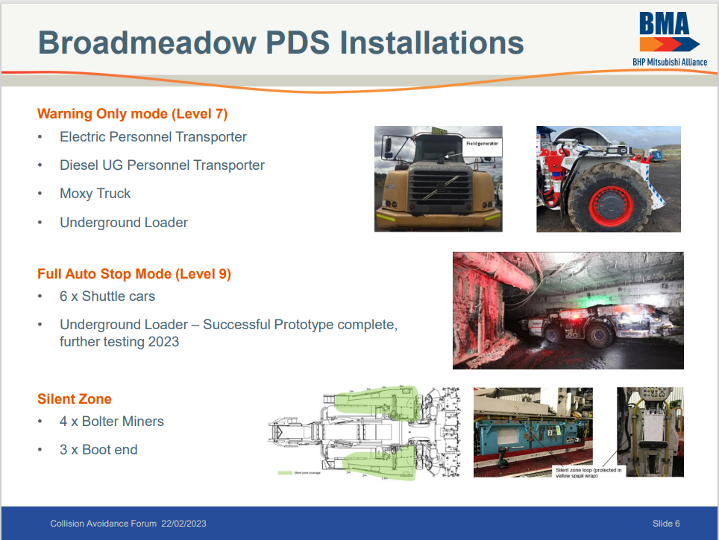

Slide 27

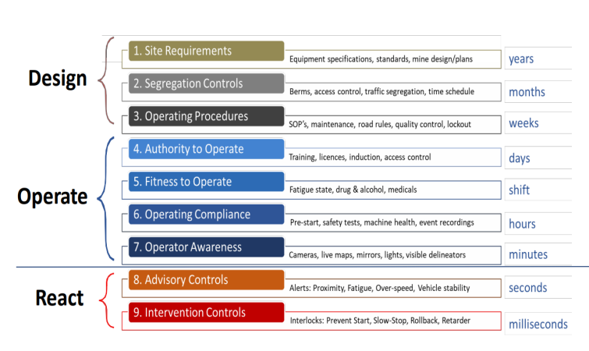

Questions?

